Slide 1
Battle of the Neighborhood
Webinar : Discussion on Neighborhood Comparison between New York and Toronto
July
2020

Slide 2

Problem statement
Compare the neighborhood between New York and Toronto and check for similarity and dissimilarly from tourist point of view regarding food, accommodation, beautiful places and many more.

Slide 3
Data SEt For Toronto Data SEt For New York City
DATA DESCRIPTION
Variable | Description
Borough | Borough in Toronto
Neighborhood | Neighborhood in Toronto
Latitudes | Latitude of Location
Longitudes | Longitudes of Location
Variable | Description
Borough | Borough in New York
Neighborhood | Neighborhood in New York
Latitudes | Latitude of Location
Longitudes | Longitudes of Location

Slide 4
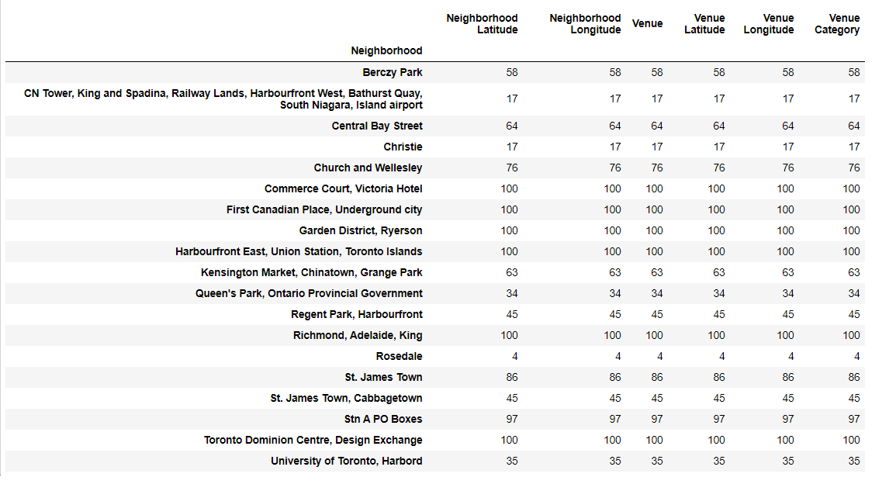
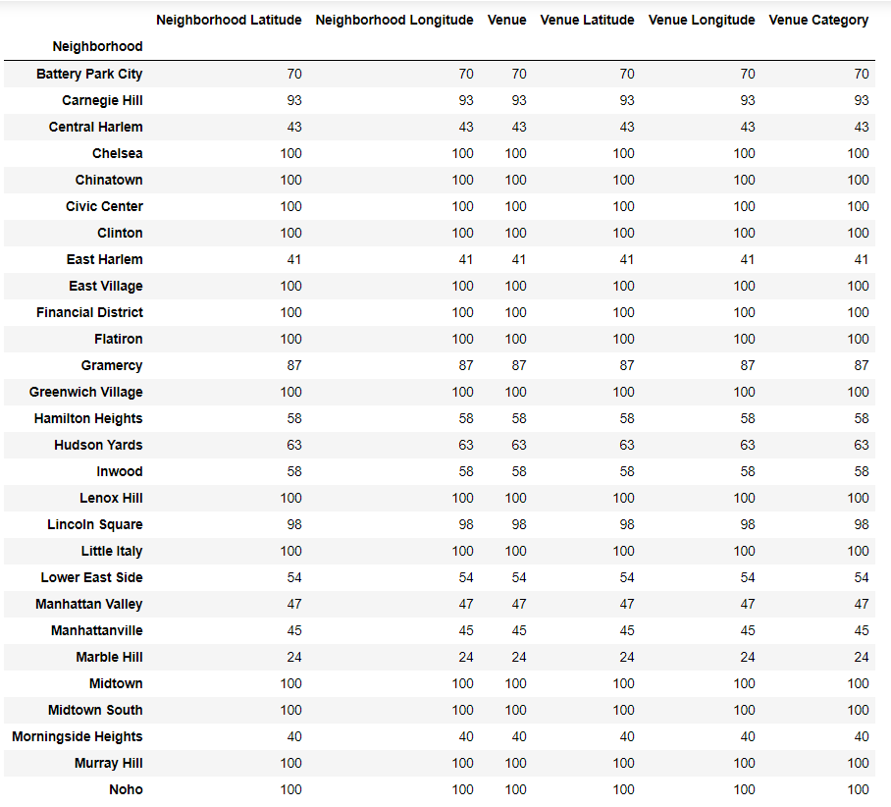
EXPLORATORY DATA ANALYSIS
Venue in Toronto Venues in New York City

Slide 5
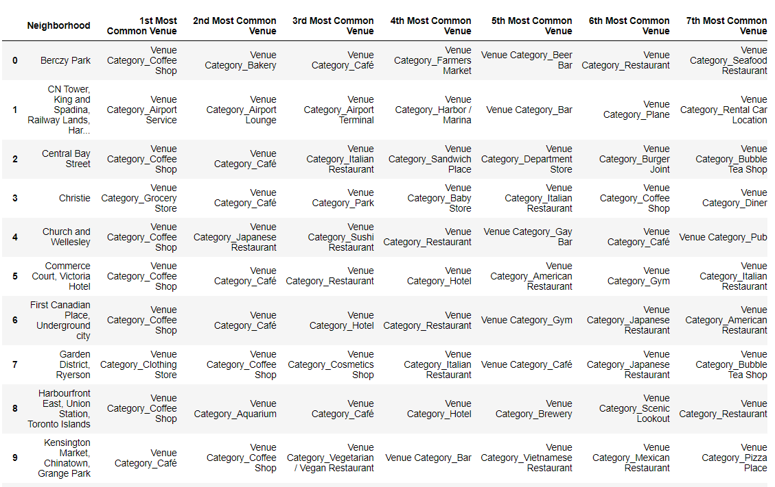
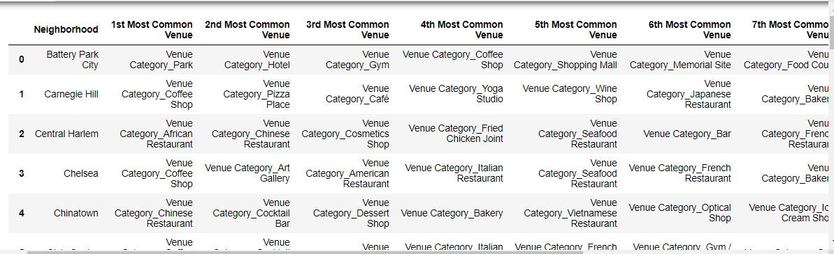
Top 10 Venues
Toronto New York City

Slide 6
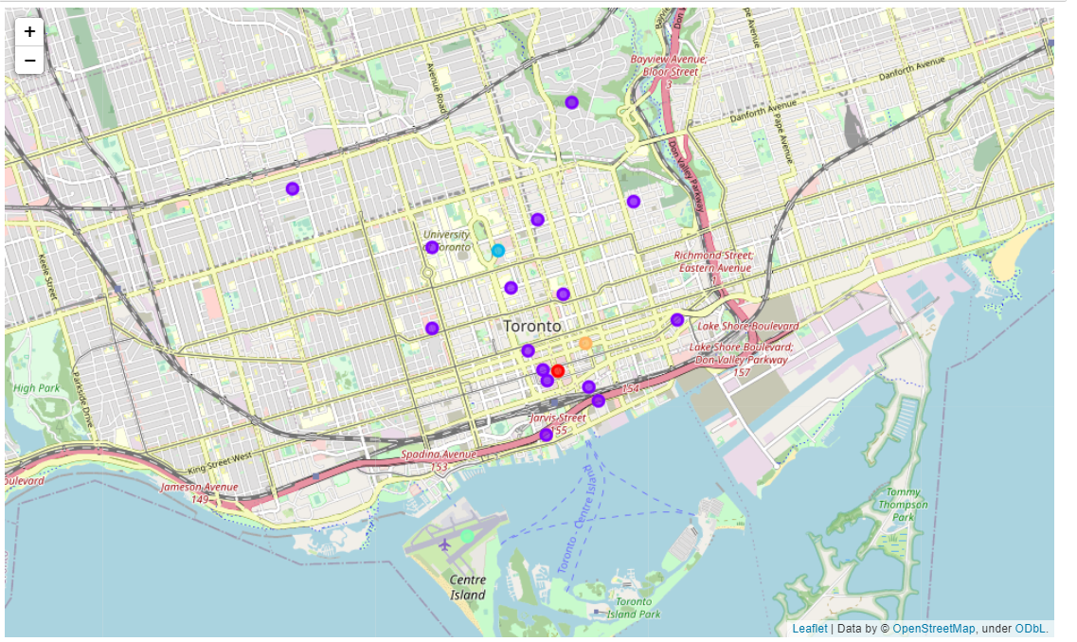
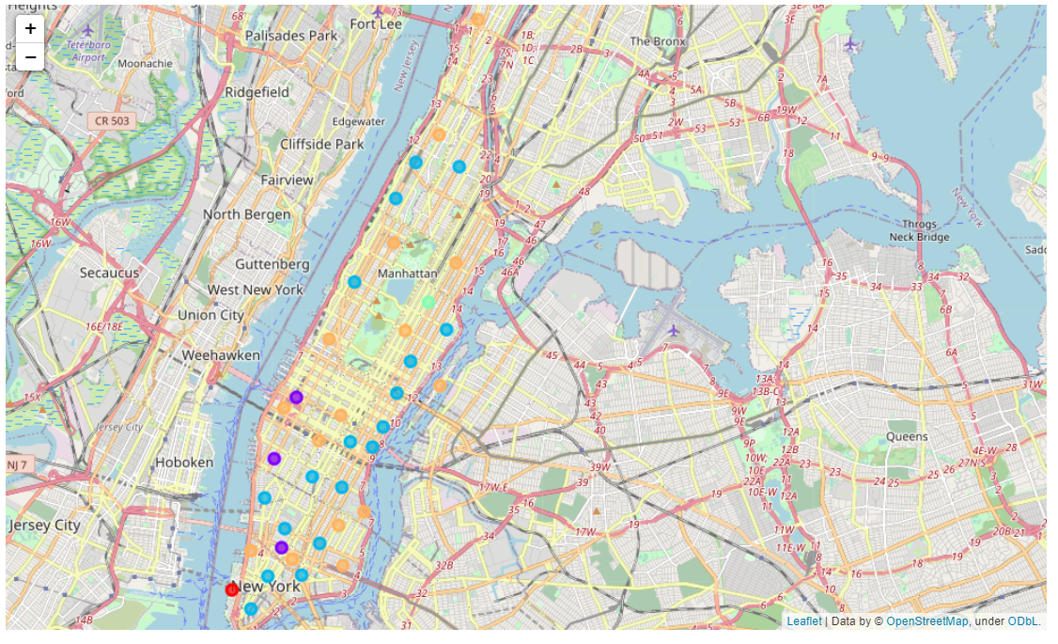
Toronto New York City
NEIGHBORHOOD CLUSTER

Slide 7
THANK YOU!!!!

